Slide 1
STAT 221-FUNDAMENTALS OF STATISTICAL DATA ANALYSIS
Week-12: Sampling and Statistical Inference- 1
Shivakumar Jolad

Slide 2
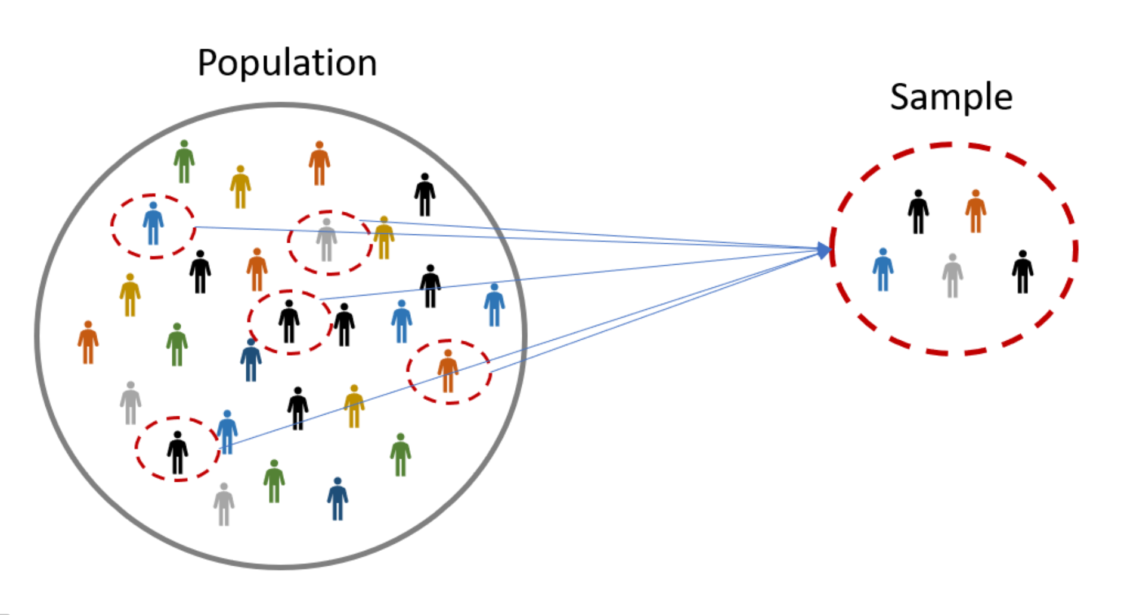
SAMPLING

Slide 3
Sampling process
A sample is “a smaller (but hopefully representative) collection of units from a population used to determine truths about that population”
Why sample?
Resources (time, money) and workload
Gives results with known accuracy that can be calculated mathematically
The sampling frame must be representative of the population
Ch 8, Bhattacherjee, Anol, "Social Science Research: Principles, Methods, and Practices" (2012). http://scholarcommons.usf.edu/oa_textbooks/3
Notes:
Population:
A population can be defined as including all people or items with the characteristic one wishes to understand.
Because there is very rarely enough time or money to gather information from everyone or everything in a population, the goal becomes finding a representative sample (or subset) of that population.
Note also that the population from which the sample is drawn may not be the same as the population about which we actually want information. Often there is large but not complete overlap between these two groups due to frame issues etc .
Sometimes they may be entirely separate - for instance, we might study rats in order to get a better understanding of human health, or we might study records from people born in 2008 in order to make predictions about people born in 2009.
The sampling frame is the list from which the potential respondents are drawn
Registrar’s office
Class rosters
Must assess sampling frame errors
Where voting is not compulsory, there is no way to identify which people will actually vote at a forthcoming election (in advance of the election)
As a remedy, we seek a sampling frame which has the property that we can identify every single element and include any in our sample .
The sampling frame must be representative of the population

Slide 4
Population and sample
What is your population of interest?
To whom do you want to generalize your results?
All doctors
School children
Indians
Women aged 15-45 years
Other
Can you sample the entire population?
When might you sample the entire population?
When your population is very small
When you have extensive resources
When you don’t expect a very high response
Supercourse on Epidemiology, Internet and Global Health, Sampling Methods
Dr. Kanupriya Chaturvedi , University of Pittsburgh,
Notes:
3 factors that influence sample representative-ness
Sampling procedure
Sample size
Participation (response)
When might you sample the entire population?
When your population is very small
When you have extensive resources
When you don’t expect a very high response

Slide 5
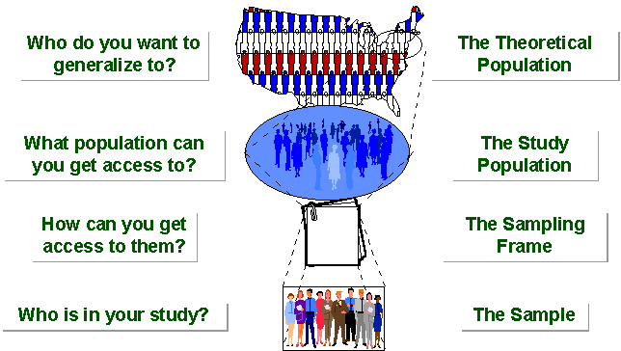
Dr. Kanupriya Chaturvedi
Notes:
Eg:
American Community Survey
The American Community Survey (ACS) is an ongoing survey by the U.S. Census Bureau. It regularly gathers information previously contained only in the long form of the decennial census, such as ancestry, citizenship, educational attainment, income, language proficiency, migration, disability, employment, and housing characteristics. These data are used by many public-sector, private-sector, and not-for-profit stakeholders to allocate funding, track shifting demographics, plan for emergencies, and learn about local communities.^{[1]} Sent to approximately 295,000 addresses monthly (or 3.5 million per year), it is the largest household survey that the Census Bureau administers.^{[2]}
The ACS has an initial sample of approximately 3.5 million housing unit addresses and group quarters in the United States. The Census Bureau selects a random sample of addresses to be included in the ACS. Each address has about a 1-in-480 chance of being selected in a given month, and no address should be selected more than once every five years. Data is collected by internet, mail, telephone interviews and in-person interviews. Approximately one third of those who do not respond to the survey by mail or telephone are randomly selected for in-person interviews. About 95 percent of households across all response modes ultimately respond.^{[16]}

Slide 6
Types of Samples
Probability (Random) Samples
Non-Probability Samples
Simple random sample
Systematic random sample
Stratified random sample
Multistage sample
Multiphase sample
Cluster sample
Convenience sample
Purposive sample
Quota
Notes:
Two general approaches to sampling are used in social science research. With probability sampling, all elements (e.g., persons, households) in the population (to be specific sampling frame) have some opportunity of being included in the sample, and the mathematical probability that any one of them will be selected can be calculated. With nonprobability sampling, in contrast, population elements are selected on the basis of their availability (e.g., because they volunteered) or because of the researcher's personal judgment that they are representative. The consequence is that an unknown portion of the population is excluded (e.g., those who did not volunteer). One of the most common types of nonprobability sample is called a convenience sample – not because such samples are necessarily easy to recruit, but because the researcher uses whatever individuals are available rather than selecting from the entire population.
Because some members of the population have no chance of being sampled, the extent to which a convenience sample – regardless of its size – actually represents the entire population cannot be known

Slide 7
SAMPLING Process
Defining the population of concern
Specifying a sampling frame (a set of items or events possible to measure )
Specifying a sampling method
Determining the sample size
Implementing the sampling plan
Sampling and data collecting
Reviewing the sampling process

Slide 8
PROBABILITY SAMPLING
A probability sampling scheme is one in which every unit in the population has a chance (greater than zero) of being selected in the sample, and this probability can be accurately determined.
EPS: When every element in the population does have the same probability of selection, this is known as an 'equal probability of selection' (EPS) design. Such designs are also referred to as 'self-weighting' because all sampled units are given the same weight.
Simple Random Sampling, Systematic Sampling, Stratified Random Sampling, Cluster Sampling, Multistage Sampling, Multiphase sampling
Supercourse on Epidemiology, Internet and Global Health, Sampling Methods
Dr. Kanupriya Chaturvedi , University of Pittsburgh,

Slide 9
NON-PROBABILITY SAMPLING
Any sampling method where some elements of population have no chance of selection (these are sometimes referred to as 'out of coverage'/'undercovered'), or where the probability of selection can't be accurately determined.
Because selection is non-random, nonprobability sampling does not allow the estimation of sampling errors, and may be subjected to a sampling bias. Therefore, information from a sample cannot be generalized back to the population.
Types: Convenient, Quota, Purposive, Snowball
From: Dr. Kanupriya Chaturvedi
Notes:
It involves the selection of elements based on assumptions regarding the population of interest, which forms the criteria for selection. Hence, because the selection of elements is nonrandom, nonprobability sampling not allows the estimation of sampling errors..
Example: We visit every household in a given street, and interview the first person to answer the door. In any household with more than one occupant, this is a nonprobability sample, because some people are more likely to answer the door (e.g. an unemployed person who spends most of their time at home is more likely to answer than an employed housemate who might be at work when the interviewer calls) and it's not practical to calculate these probabilities.
Nonprobability Sampling includes: Accidental Sampling, Quota Sampling and Purposive Sampling. In addition, nonresponse effects may turn any probability design into a nonprobability design if the characteristics of nonresponse are not well understood, since nonresponse effectively modifies each element's probability of being sampled.

Slide 10
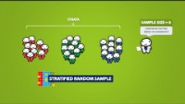
https://www.youtube.com/watch?v=pTuj57uXWlk

Slide 11
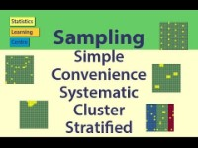
https://www.youtube.com/watch?v=be9e-Q-jC-0
Sampling: Simple Random, Convenience, systematic, cluster, stratified

Slide 12
Simple random sampling
In this technique, all possible subsets of a population (more accurately, of a sampling frame) are given an equal probability of being selected.
The probability of selecting any set of n units out of a total of N units in a sampling frame is ^{N}C_{n}.
Table of Random numbers (old time), Computer generated random numbers (most common)
Sampling with Replacement (SWR)- and Sampling without Replacement (SWoR)
Disadvantages :
If sampling frame large, this method impracticable.
Minority subgroups of interest in population may not be present in sample in sufficient numbers for study.
Anol Bhattacherjee
Notes:
Simple random sampling is always an EPS (Equal Probability of Selection) design, but not all EPS designs are simple random sampling.
Applicable when population is small, homogeneous & readily available
All subsets of the frame are given an equal probability. Each element of the frame thus has an equal probability of selection.
It provides for greatest number of possible samples. This is done by assigning a number to each unit in the sampling frame.
A table of random number or lottery system is used to determine which units are to be selected.

Slide 13
SYSTEMATIC SAMPLING
Systematic sampling relies on arranging the target population according to some ordering scheme and then selecting elements at regular intervals through that ordered list.
It is important that the starting point is not automatically the first in the list, but is instead randomly chosen from within the first to the kth element in the list.
Eg: ASER Survey: Every fifth household in a village
It is not 'simple random sampling' because different subsets of the same size have different selection probabilities - e.g. the set {4,14,24,...,994} has a one-in-ten probability of selection, but the set {4,13,24,34,...} has zero probability of selection.
Notes:
Systematic sampling involves a random start and then proceeds with the selection of every kth element from then onwards. In this case, k=(population size/sample size).
A simple example would be to select every 5th name from the telephone directory (an 'every 10th' sample, also referred to as 'sampling with a skip of 10’).
ADVANTAGES:
Sample easy to select
Suitable sampling frame can be identified easily
Sample evenly spread over entire reference population
DISADVANTAGES:
Sample may be biased if hidden periodicity in population coincides with that of selection.
Difficult to assess precision of estimate from one survey.

Slide 14
Stratified sampling
Where population embraces a number of distinct categories, the frame can be organized into separate "strata." Each stratum is then sampled as an independent sub-population, out of which individual elements can be randomly selected.
Every unit in a stratum has same chance of being selected.
Using same sampling fraction for all strata ensures proportionate representation in the sample.
Adequate representation of minority subgroups of interest can be ensured by stratification & varying sampling fraction between strata as required.
Issue of Bias in sampling- Non proportional stratification
Proportional stratification
Notes:
Finally, since each stratum is treated as an independent population, different sampling approaches can be applied to different strata.
the previous example of selecting 200 firms from a list of 1000 firms, you can start by categorizing the firms based on their size as large (more than 500
employees), medium (between 50 and 500 employees), and small (less than 50 employees). You can then randomly select 67 firms from each subgroup to make up your sample of 200
firms. However, since there are many more small firms in a sampling frame than large firms, having an equal number of small, medium, and large firms will make the sample less
This is called non-proportional stratified sampling because the
proportion of sample within each subgroup does not reflect the proportions in the sampling
frame (or the population of interest), and the smaller subgroup (large-sized firms) is oversampled.
Drawbacks to using stratified sampling.
First, sampling frame of entire population has to be prepared separately for each stratum
Second, when examining multiple criteria, stratifying variables may be related to some, but not to others, further complicating the design, and potentially reducing the utility of the strata.
In some cases (such as designs with a large number of strata, or those with a specified minimum sample size per group), stratified sampling can potentially require a larger sample than would other methods

Slide 15
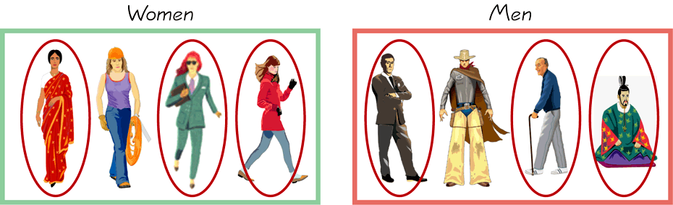
STRATIFIED SAMPLING
Draw a sample from each stratum
Supercourse on Epidemiology, Internet and Global Health, Sampling Methods
Dr. Kanupriya Chaturvedi , University of Pittsburgh,

Slide 16
Cluster sampling
Population divided into clusters of homogeneous units, usually based on geographical contiguity.
Cluster sampling is an example of 'two-stage sampling' .
First stage a sample of areas is chosen;
Second stage a sample of respondents within those areas is selected.
Sampling units are groups rather than individuals.
A sample of such clusters is then selected.
All units from the selected clusters are studied.
Notes:
If you have a population dispersed over a wide geographic region, it may not be feasible to conduct a simple random sampling of the entire population. In such case,
it may be reasonable to divide the population into “clusters” (usually along geographic boundaries), randomly sample a few clusters, and measure all units within that cluster
Advantages :
Cuts down on the cost of preparing a sampling frame.
This can reduce travel and other administrative costs.
Disadvantages: sampling error is higher for a simple random sample of same size.
The NFHS-4 sample is a stratified two-stage sample. The 2011 census served as the sampling frame for the selection of PSUs. PSUs were villages in rural areas and Census Enumeration Blocks (CEBs) in urban areas. PSUs with fewer than 40 households were linked to the nearest PSU. Within each rural stratum, villages were selected from the sampling frame with probability proportional to size (PPS). In each stratum, six approximately equal substrata were created by crossing three substrata, each created based on the estimated number of households in each village, with two substrata, each created based on the percentage of the population belonging to scheduled castes and scheduled tribes (SCs/STs).

Slide 17
CLUSTER SAMPLING…….
Two types of cluster sampling methods.
One-stage sampling. All of the elements within selected clusters are included in the sample.
Two-stage sampling. A subset of elements within selected clusters are randomly selected for inclusion in the sample.
Supercourse on Epidemiology, Internet and Global Health, Sampling Methods
Dr. Kanupriya Chaturvedi , University of Pittsburgh,
Notes:
Multi stage sampling:
Complex form of cluster sampling in which two or more levels of units are embedded one in the other.
First stage, random number of districts chosen in all states.
Followed by random number of talukas, villages.
Then third stage units will be houses.
All ultimate units (houses, for instance) selected at last step are surveyed

Slide 18
Cluster sampling
Section 1
Section 2
Section 3
Section 5
Section 4

Slide 19
Difference Between Strata and Clusters
Although strata and clusters are both non-overlapping subsets of the population, they differ in several ways.
All strata are represented in the sample; but only a subset of clusters are in the sample.
With stratified sampling, the best survey results occur when elements within strata are internally homogeneous. However, with cluster sampling, the best results occur when elements within clusters are internally heterogeneous

Slide 20
Multi-stage sampling
Complex form of cluster sampling in which two or more levels of units are embedded one in the other.
First stage, random number of districts chosen in all states.
Followed by random number of talukas, villages.
Then third stage units will be houses.
All ultimate units (houses, for instance) selected at last step are surveyed

Slide 21
Non-probability sampling: Convenience
Sometimes known as grab or opportunity sampling or accidental or haphazard sampling.
A type of nonprobability sampling which involves the sample being drawn from that part of the population which is close to hand. That is, readily available and convenient.
The researcher using such a sample cannot scientifically make generalizations about the total population from this sample because it would not be representative enough.
This type of sampling is most useful for pilot testing.
Notes:
For example, if the interviewer was to conduct a survey at a shopping center early in the morning on a given day, the people that he/she could interview would be limited to those given there at that given time, which would not represent the views of other members of society in such an area, if the survey was to be conducted at different times of day and several times per week.
In social science research, snowball sampling is a similar technique, where existing study subjects are used to recruit more subjects into the sample.

Slide 22
Other sampling
Judgmental sampling or Purposive sampling: The researcher chooses the sample based on who they think would be appropriate for the study. This is used primarily when there is a limited number of people that have expertise in the area being researched
Snowball Sampling: In snowball sampling, you start by identifying a few respondents that match the criteria for inclusion in your study, and then ask them to recommend others they know who also meet your selection criteria.

Slide 23
STATISTICAL INFERENCE

Slide 24
Distinctions Between Parameters and Statistics
 | Parameters | Statistics
Source | Population | Sample
Notation | Greek (e.g., μ) | Roman (e.g., xbar)
Vary | No | Yes
Calculated | No | Yes
Notes:
This slide address an other foundation of statistical inference: the difference between parameters and statistics. Parameters and statistics are related, but are not the same thing.
Over the years teaching statistics, I have derived a hypothesis that explains why some students have difficulty with statistical inference: they fail to distinguish between statistics and parameter. When a student calculates a statistic such as a sample mean, it seems so tangible and real that they view it as a constant. I think they would be better off if they recognized a statistic as merely one example of what might have been had they done the study or experiment at a different time.

Slide 25
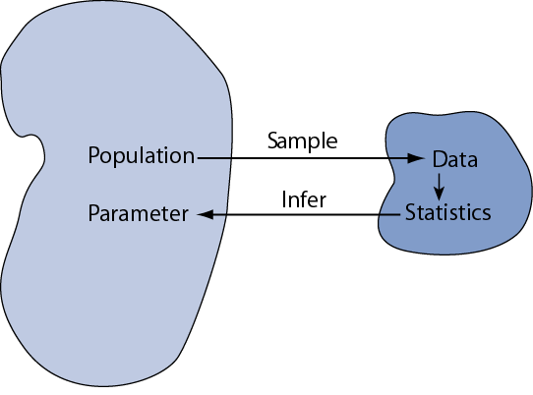

Slide 26
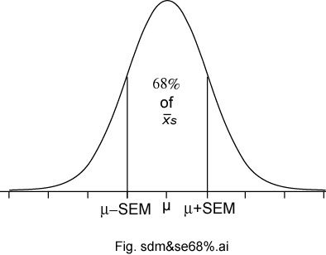
Sampling Distributions of a Mean (Introduced in Ch 8)
The sampling distributions of a mean (SDM) describes the behavior of a sampling mean
Notes:
This slide summarize what we’ve learned about the sampling distribution of a mean from a large sample. It is based no three important sampling postulates: the central limit theorem, the law of large numbers (unbiased nature of the sample mean), and square root law. Based on these well established statistical theorems we can say that means based on large samples (and means based in Normal populations) will have a Normal sampling distribution with an expectation equal to the population mean with a standard deviation equal to the standard deviation of the population divided by the square root of the sample size n.

Slide 27
PUNE SCHOOLS EXAMPLE
7455 schools
School Management | Dept of Edu | Tribal Welfare | Local body | Govt Aided | Private Unaided | Unrecognized | Social Welfare | KVS | JNV | Madrassa | Unknown | Total
1 |  |  | 2906 | 189 | 318 | 20 | 1 |  |  |  |  | 3434
2 | 2 | 2 | 1188 | 202 | 539 | 13 | 1 |  |  | 1 |  | 1948
3 |  | 5 | 5 | 279 | 205 | 2 |  | 14 |  |  | 1 | 511
4 |  |  |  |  | 4 |  |  |  |  |  |  | 4
5 |  |  | 4 | 45 | 47 |  |  |  | 1 |  |  | 97
6 |  | 13 | 14 | 370 | 346 | 1 | 1 | 1 |  |  |  | 746
7 |  |  | 34 | 220 | 189 | 1 | 4 |  |  |  |  | 448
8 |  |  | 13 |  | 61 | 4 |  |  |  |  |  | 78
10 |  |  |  |  | 16 |  |  |  |  |  |  | 16
11 |  |  |  | 41 | 132 |  |  |  |  |  |  | 173
Grand Total | 2 | 20 | 4164 | 1346 | 1857 | 41 | 7 | 15 | 1 | 1 | 1 | 7455

Slide 28
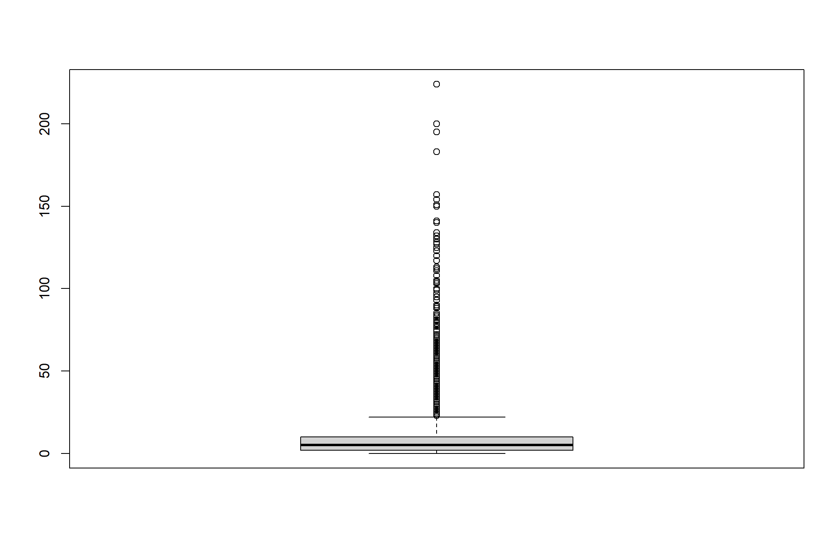
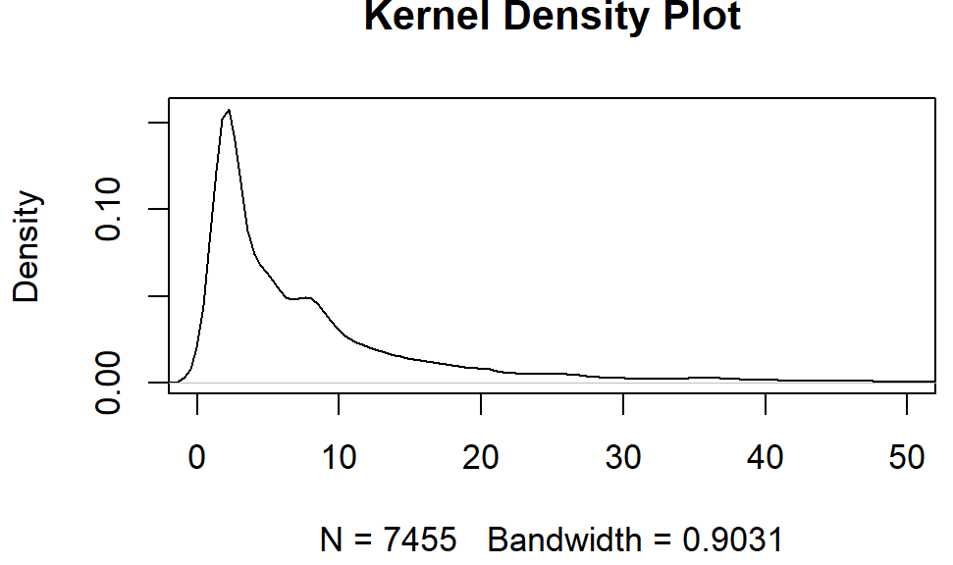
TEACHERS in Schools- ALL UDISE Census
Mean – mu = 9.47
Sigma= 14.19

Slide 29
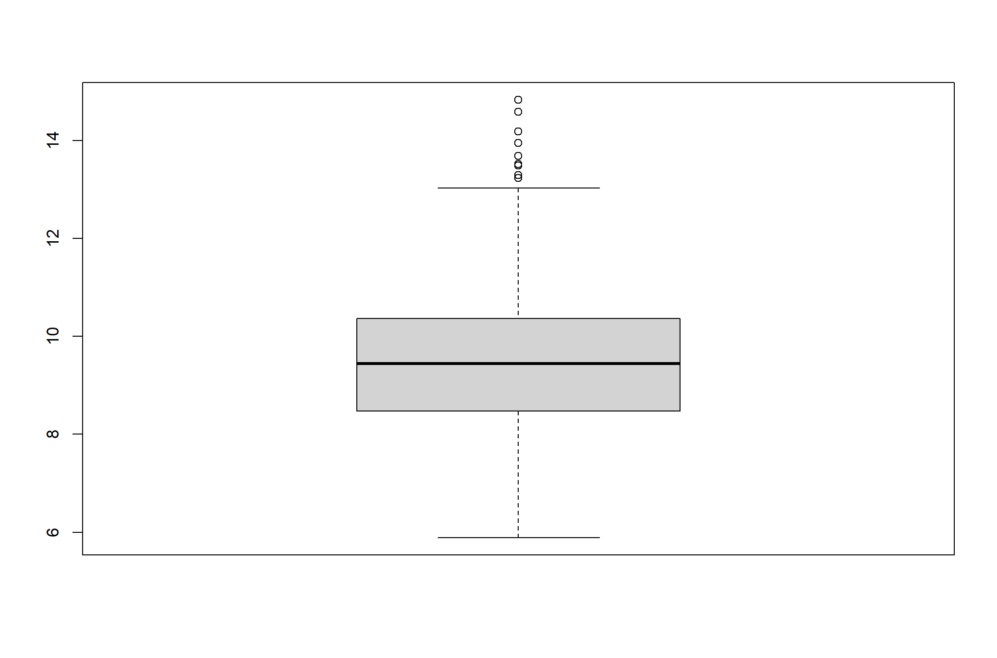
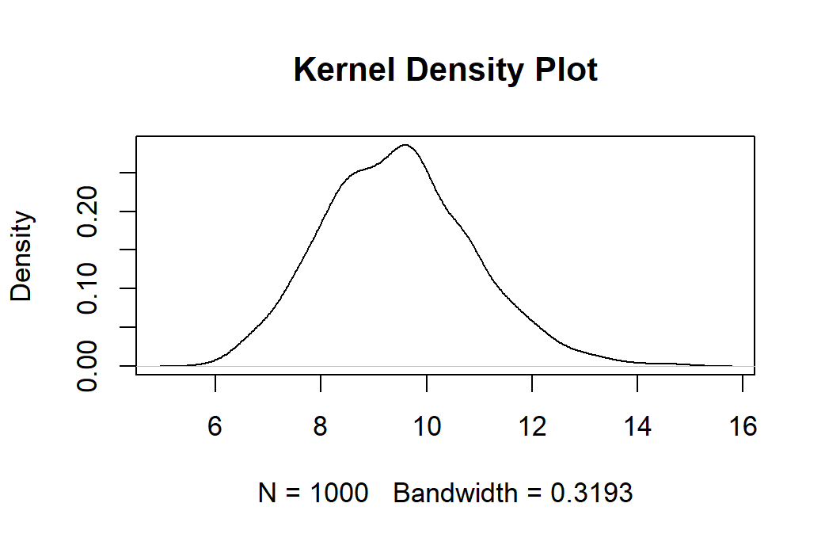
Sample of schools and teachers
xbar= 9.45826
SE=1.412487
mu= 9.474581
sigma/sqrt(num_schools_per_sample) =1.420
Sample size =100
No of samples = 1000

